Slide 1
RUSH COPLEY RECORDS
Joseph Kovack
Kathleen Sweeney
Kristina Krokosz
Dylan Knuth

Slide 2
Contributions
Joseph Kovack - Database/Project Leader
Kathleen Sweeney - Rails
Kristina Krokosz - Rails
Dylan Knuth - Rails

Slide 3
PROJECT OVERVIEW
Project is being built for Doctor Bob of Rush Copley Medical Group in house application.
To provide a application that is to be able to view patients medical records and their health care providers from one source.
Main use is for Hospitals employees which would have the ability to recall the information for review or edit.

Slide 4
PROJECT FUNCTIONS
Provides a database that contains records of: individuals, health care providers, hospitals, and employees
Add, edit, view, and drop information about users
Admin abilities to edit information
Log on capabilities
Local in house capability

Slide 5
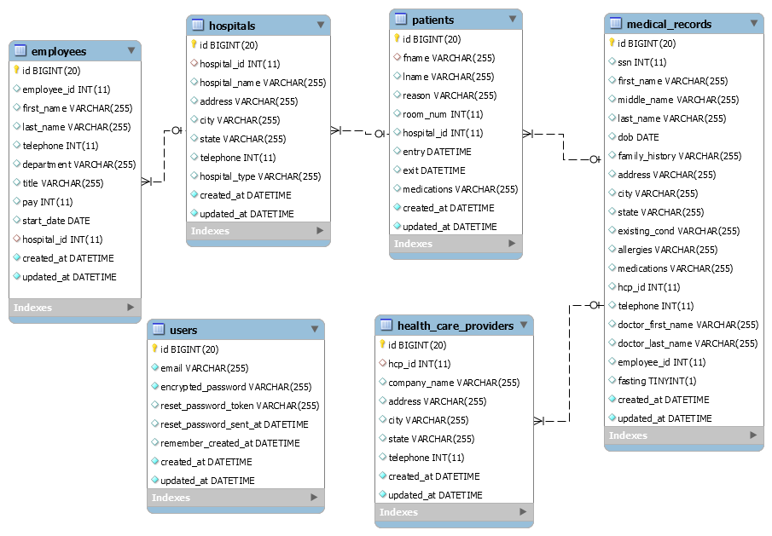

Slide 6
BOOTSTRAP
Repeated issues with bootstrap when implemented.
Decided to remove it for the sake of functionality

Slide 7
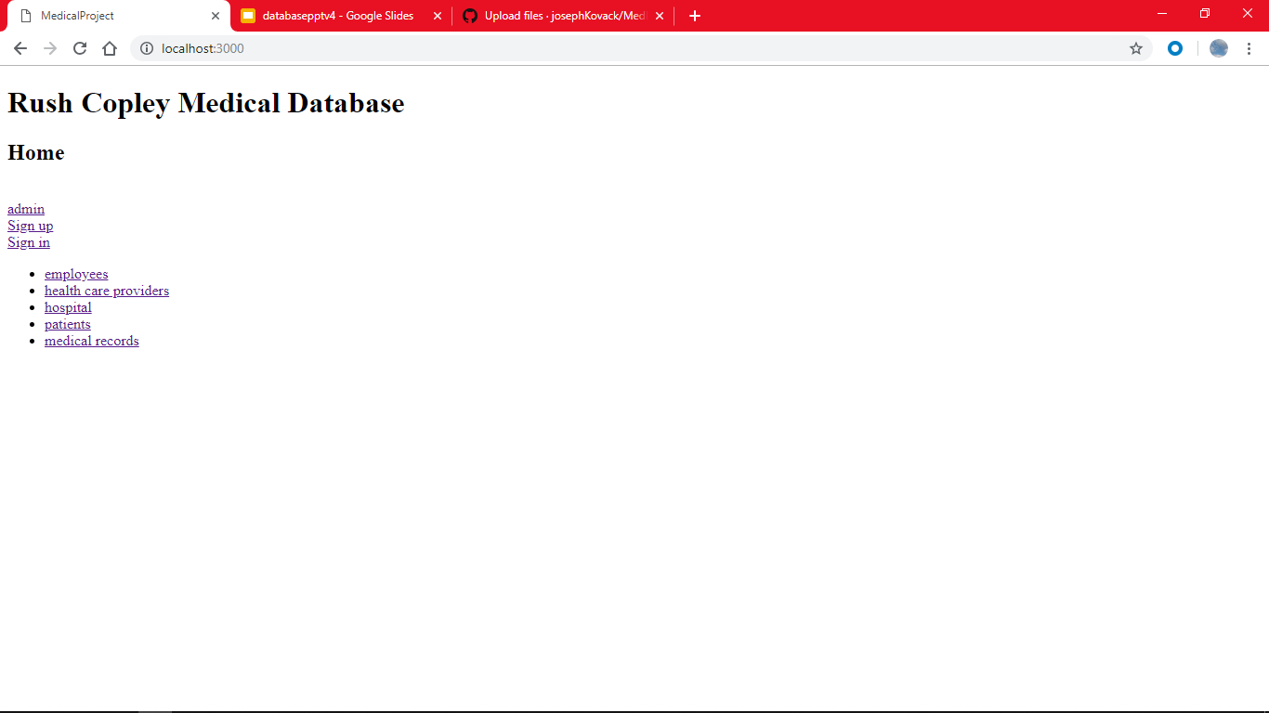
HOME PAGE
Lands on the home page.
Has links to all the other pages.
Can be accessed without sign in.

Slide 8
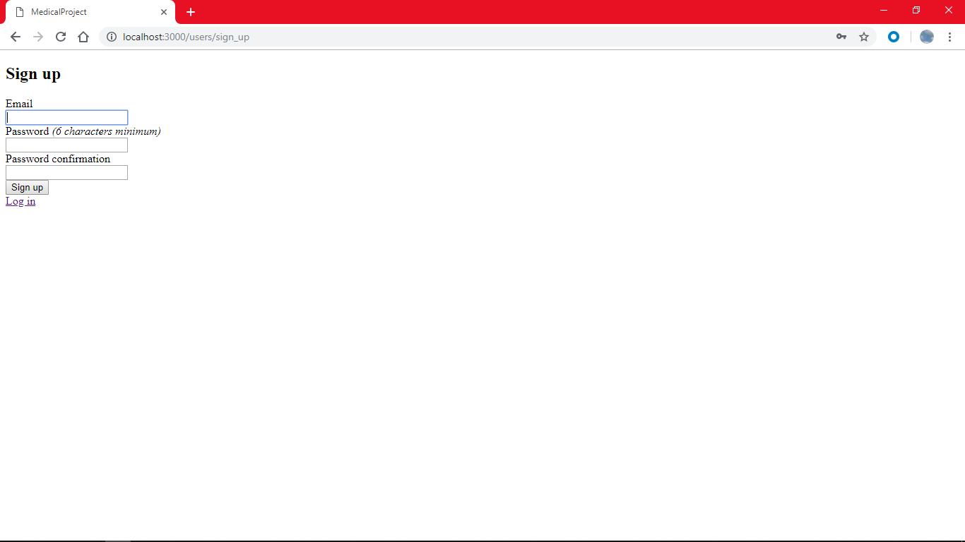
SIGN IN/UP
Sign in/up requires username and password.
Easy sign in and sign up.

Slide 9
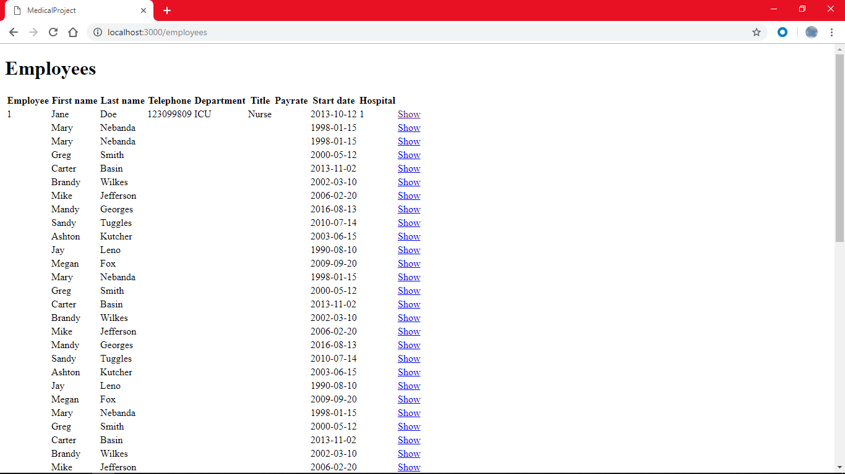
EMPLOYEES
Ability to view information without sign in.
Unable to edit or delete entries.

Slide 10
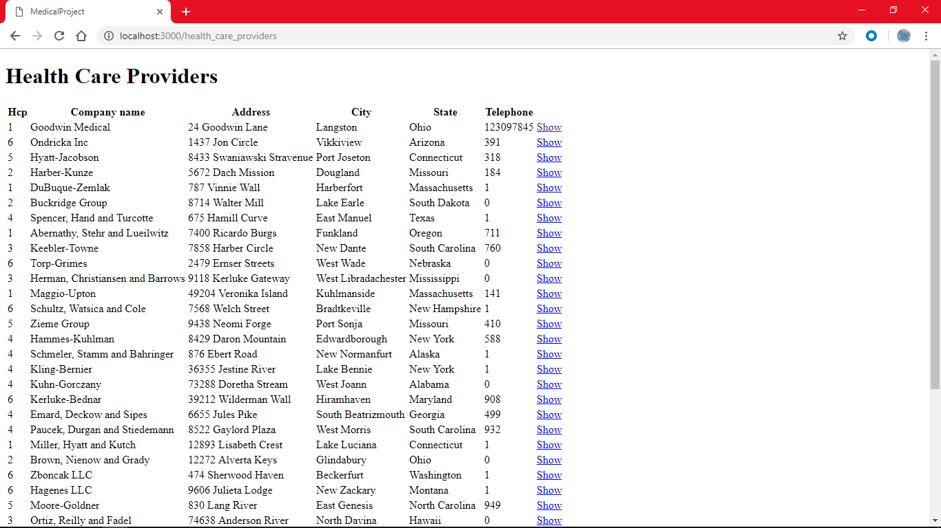
HEALTH CARE PROVIDERS
Restricted edit or deletion

Slide 11
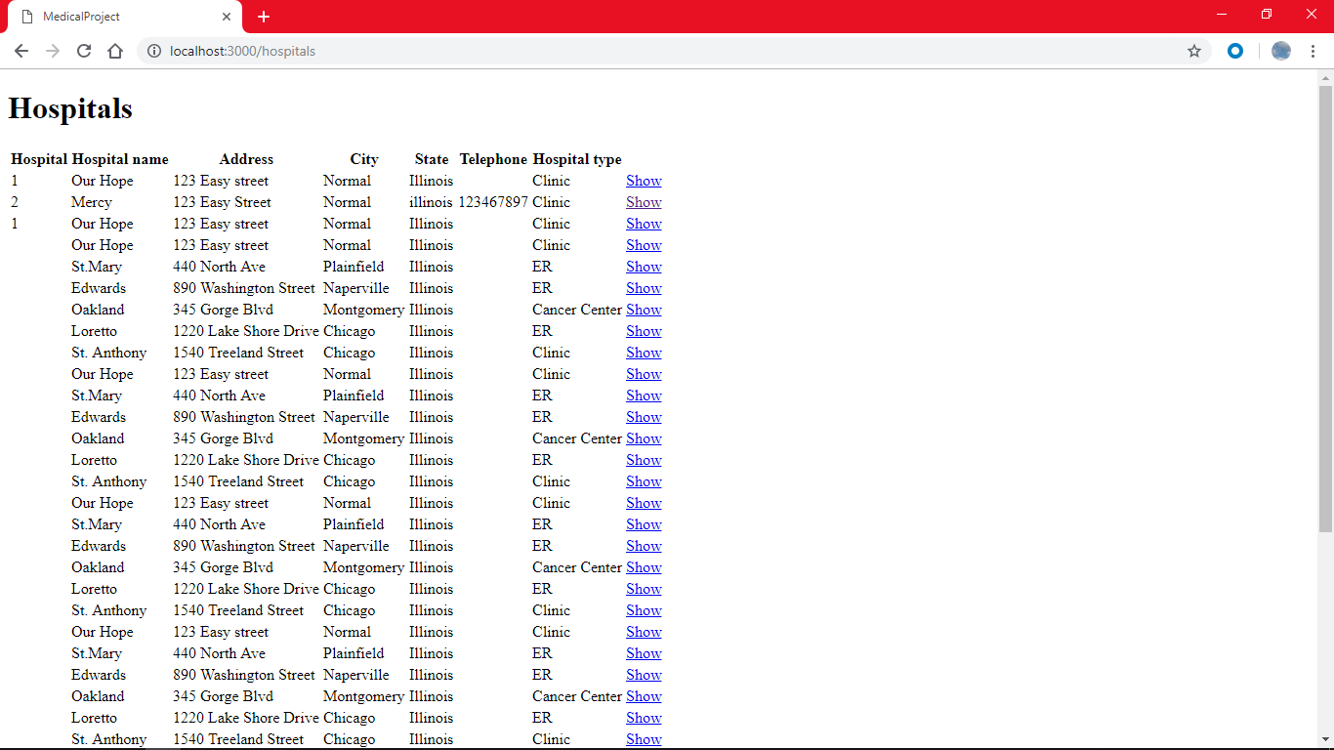
HOSPITALS
Limited editing.

Slide 12
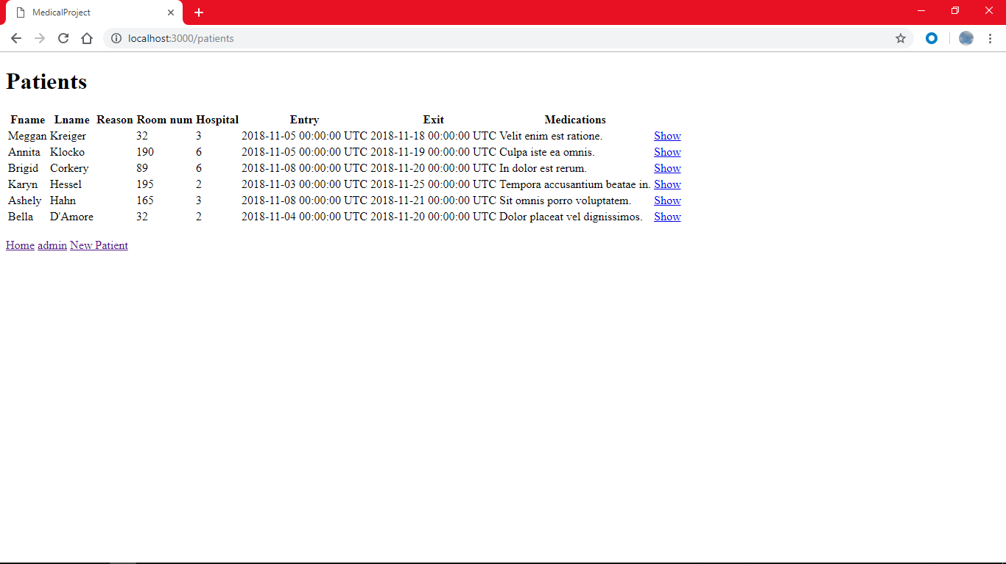
PATIENTS
Can add new patients, unable to remove without admin due to requirements to keep patient records.

Slide 13
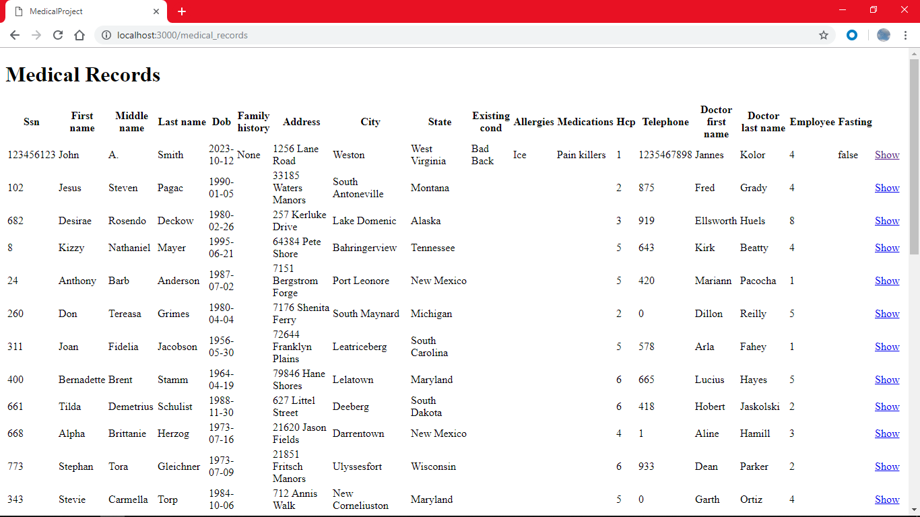
MEDICAL RECORDS
Medical records can be added to but not deleted or edited from this page.

Slide 14
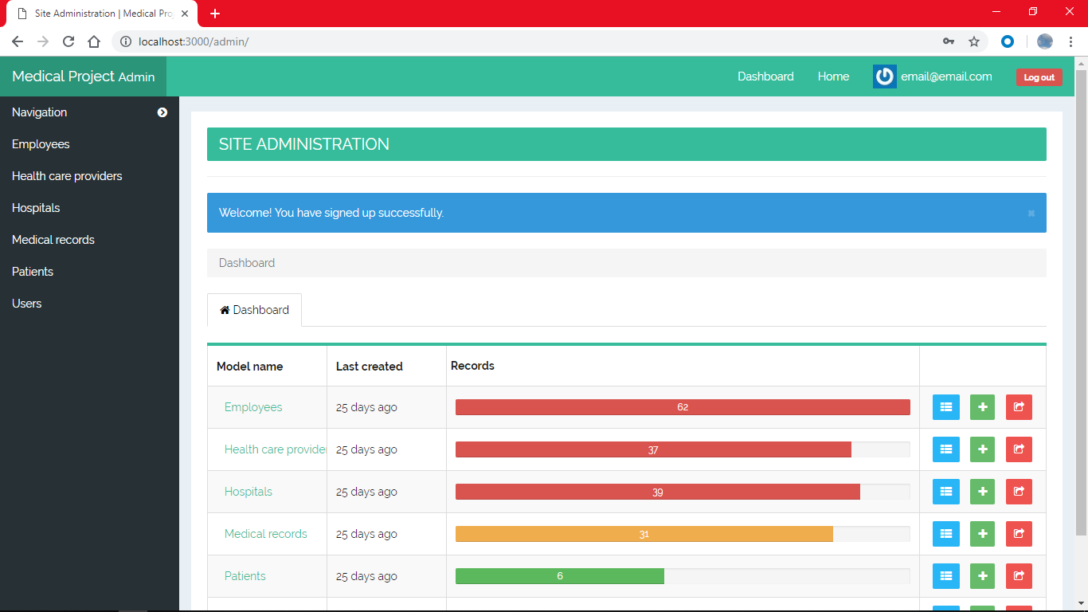
ADMIN
The only place a user can edit or delete information in the database.
Requires sign in to access.

Slide 15
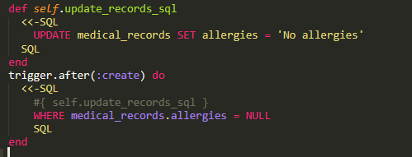
TRIGGER
Used “HairTrigger” gem
Execute on creation of new data

Slide 16
CONCLUSION
Simplistic Design
Easy to navigate
Useful admin tool
Easy to maintain

Slide 17
END
DEMO TIME

